Slide 1
Technology Track Update
What’s been happening, what should happen next …
https://github.com/stichtingsem/technology-prototype

Slide 2
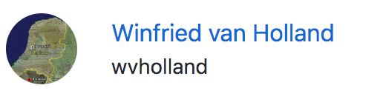

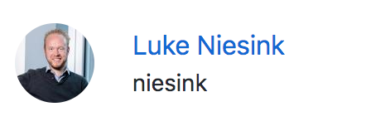







Who we are

Slide 3
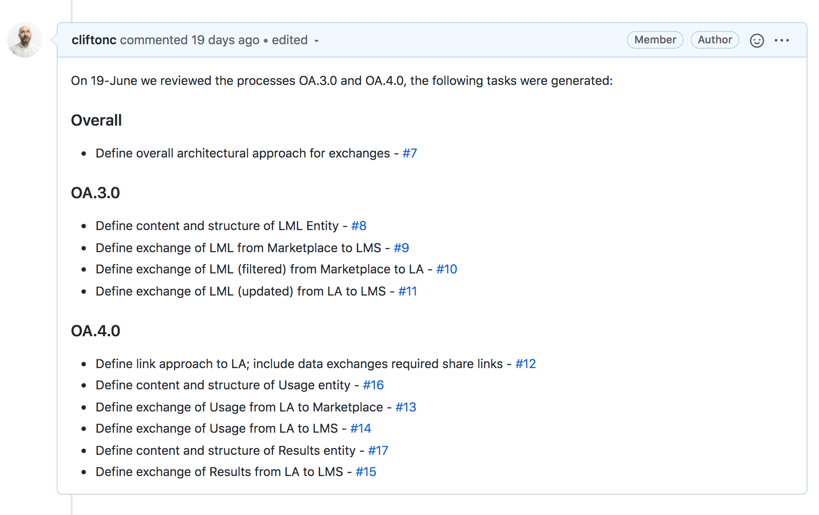
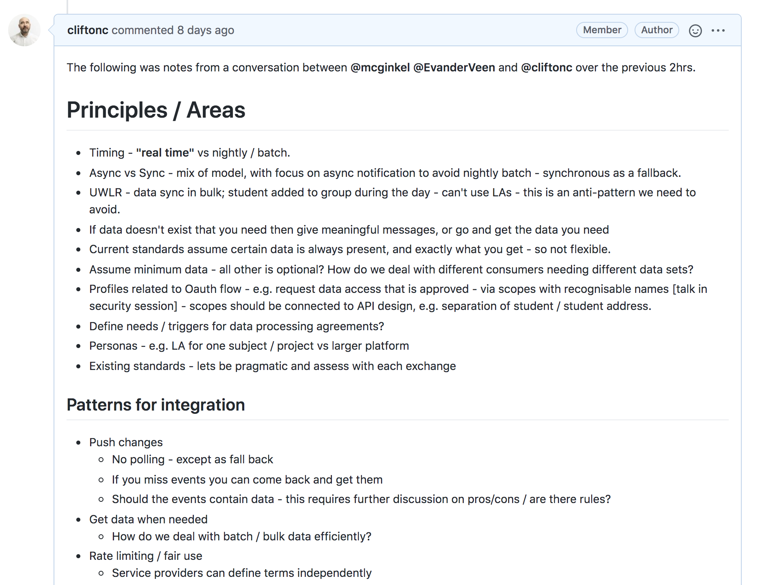
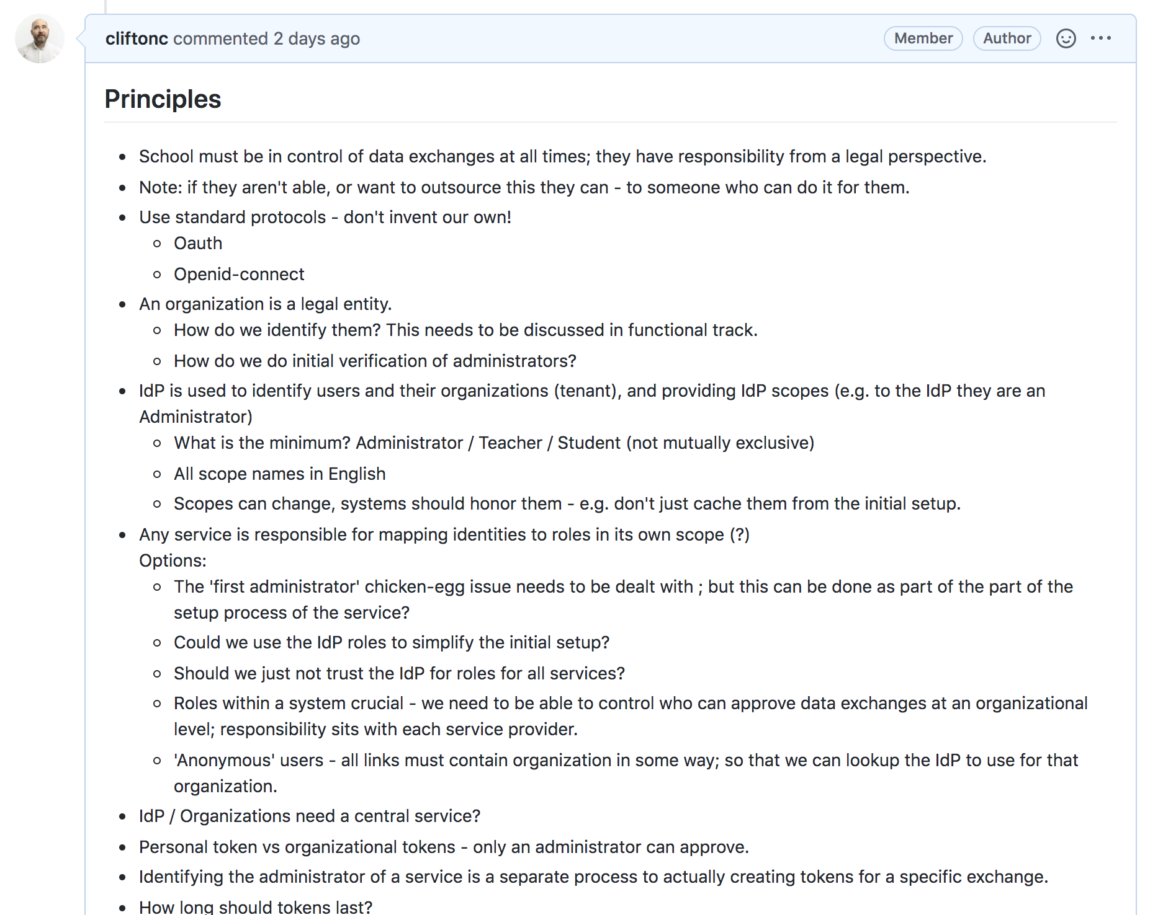
What we’ve been doing
Breaking up the work
Architecture - Exchanges
Architecture - Security

Slide 4
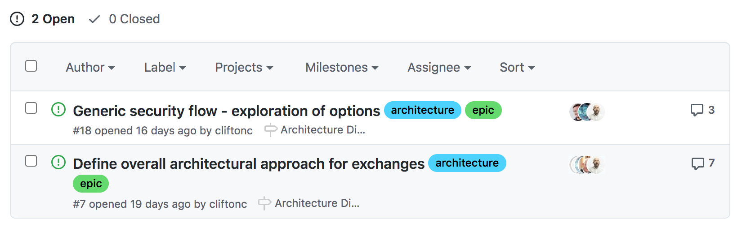
Breaking up the work - Architecture

Slide 5
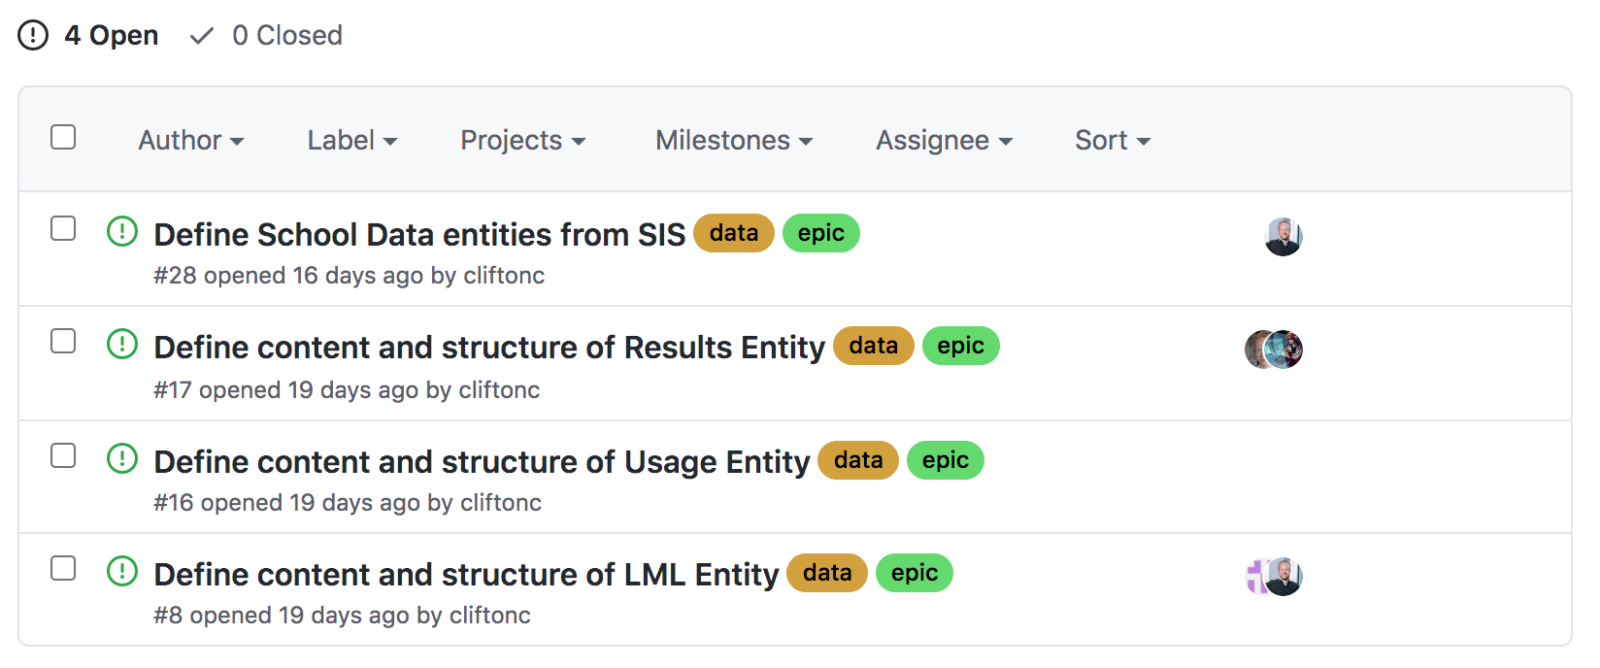
Breaking up the work – Data

Slide 6
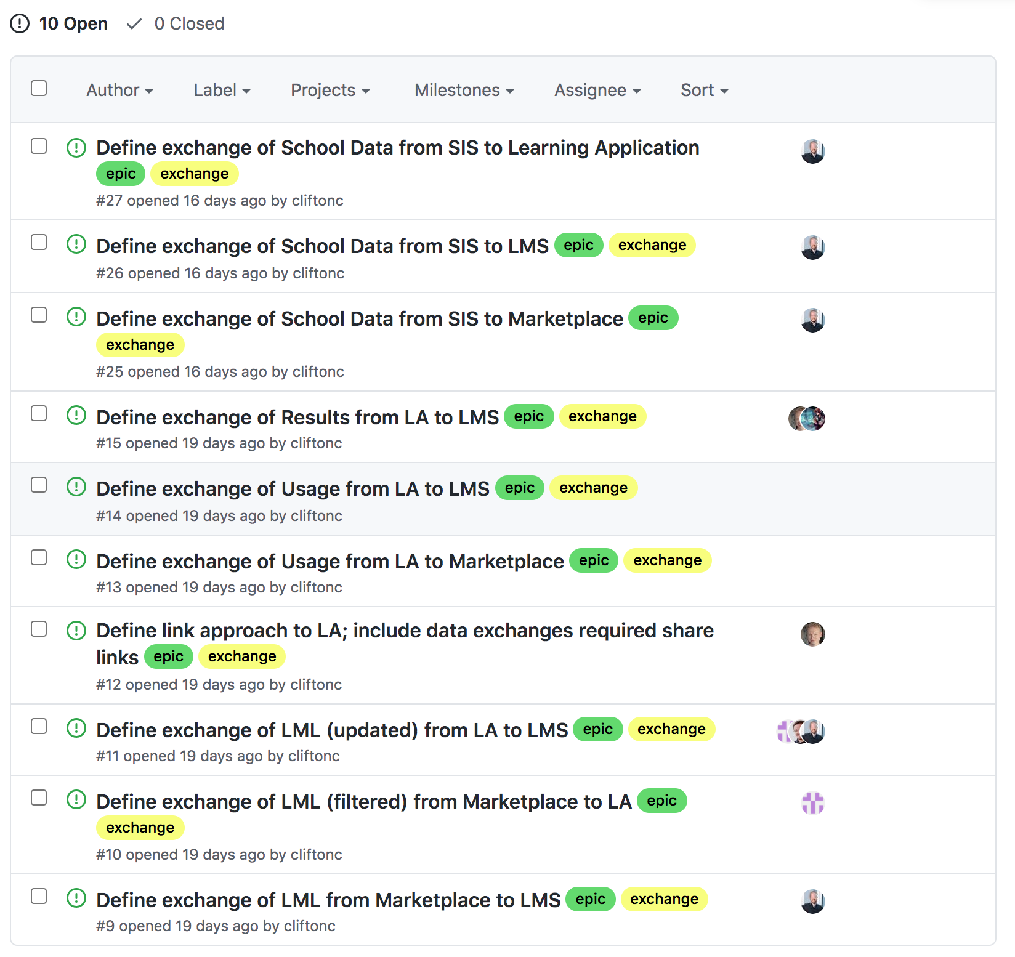
Breaking up the work - Exchanges
Data
Exchanges

Slide 7
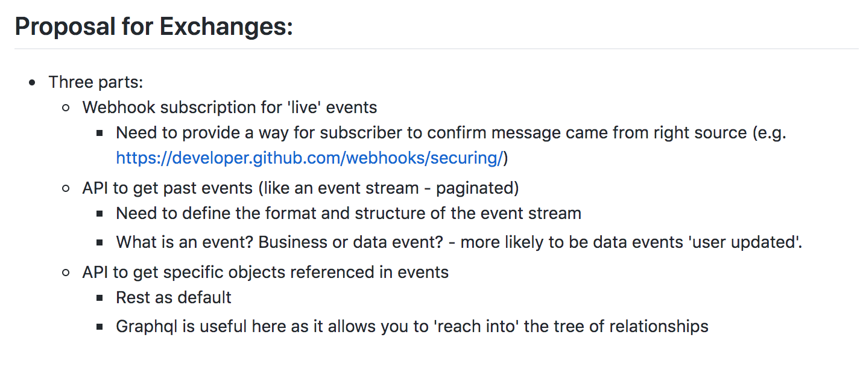
Architecture - Exchanges

Slide 8
Architecture – Exchanges … Visual
Provider
(e.g. SIS)
Subscriber
[Security/Setup]
Registration of Web–Hook Receiver
Web-Hook API
Event
POST of Event data
Web-Hook Receiver
Event
Event
Event API
Query past events
Entity API 1
Get specific data entities
Entity API … N
All HTTPS
All HTTPS

Slide 9
Architecture – Exchanges – Why is this better?
Approach is modern with simple technology
Subscribers can choose how they want to receive the data with any combination of:
Real time via web-hook
Poll for changed data via the event API
Request specific entities on demand
The real time approach allows us to spread the data exchange load across the day, no longer costly loads over night.
Designed for reliability; you can always ask for data you have missed (if your platform was down), or in the case of inconsistent data ask the provider for it directly.
Assumption is that subscribers cache data for performance and resilience (if provider is down), however providers will likely rate limit Entity API’s to avoid direct coupling (e.g. a LA calling the MP on every student login)
For sensitive data the event can should only a notification of what happened, requiring the subscriber to call back and ask for it. This ensures that no data can be pushed to a participant who shouldn’t have it – provider (school) always in control.
Providers can limit access to specific data entities (e.g. fields on a user object – like address data) via Oauth scopes that need to be approved when the connection is made between subscriber and provider – very fine grained control possible, with revocation.

Slide 10
Architecture - Security
We will use Oauth and Openid-connect
Control over the connection of services and the scopes requested for data exchange always in the control of the school
The IdP for the school is essential used to identify users and their organizations (tenant), and providing IdP scopes (e.g. to the IdP they are an Administrator)
It is essential that we have a clear definition of what an Organization is – this has been passed to the functional / administration track
The initial setup of a service is crucial – e.g. the addition of a new Marketplace – we need to solve the ‘first administrator’ issue, where it is essential we securely identify which identity is able to administer that service on behalf of the organization, discussion ongoing re. ”trust” of IdP to provide these roles to the ecosystem.
We have identified that if there was a central ”discovery” service available, that allowed a school to make available some basic information: What its organizations are, where and what it’s IdP is, what and where it’s SIS is – this would simplify setup and reduce manual steps / errors. This is a service to speed up setup, not an operational one.

Slide 11
Architecture – Security – Prototype scope
Focus on a generic concept of an ‘Organization’ at this stage
Build example of API for requesting access to a service APIs
Define this registration API – can we re-use the Oauth registration API
Show how the Administrator can see and approve the request
Subscriber then gets a token it can use to interact with the API
Use SIS as the example
All other API requests in the prototype will use dummy tokens

Slide 12
What’s next
We have agreed that the API’s will be documented in OpenAPI v3
There is a live documentation site that will be updated as we create each API definition
https://stichtingsem.stoplight.io/
We have broken all the work into Github issues, and members of the track have self-assigned themselves – over coming weeks we will (hopefully) have time to gather in these smaller groups and define initial version of each of the exchanges
I will continue to co-ordinate, and be involved in as many of those groups as possible
Once we have API definitinons for key exchanges, we will build a walking skeleton of each service to demonstrate how the exchanges work end to end (likely into August)
Questions?

